Slide 1
Chapter 6 Methods

Slide 2
Opening Problem
Find the sum of integers from 1 to 10, from 20 to 30, and from 35 to 45, respectively.

Slide 3
Problem
int sum = 0;
for (int i = 1; i <= 10; i++)
sum += i;
System.out.println("Sum from 1 to 10 is " + sum);
sum = 0;
for (int i = 20; i <= 30; i++)
sum += i;
System.out.println("Sum from 20 to 30 is " + sum);
sum = 0;
for (int i = 35; i <= 45; i++)
sum += i;
System.out.println("Sum from 35 to 45 is " + sum);

Slide 4
Problem
int sum = 0;
for (int i = 1; i <= 10; i++)
sum += i;
System.out.println("Sum from 1 to 10 is " + sum);
sum = 0;
for (int i = 20; i <= 30; i++)
sum += i;
System.out.println("Sum from 20 to 30 is " + sum);
sum = 0;
for (int i = 35; i <= 45; i++)
sum += i;
System.out.println("Sum from 35 to 45 is " + sum);

Slide 5
Solution
public static int sum(int i1, int i2) {
int sum = 0;
for (int i = i1; i <= i2; i++)
sum += i;
return sum;
}
public static void main(String[] args) {
System.out.println("Sum from 1 to 10 is " + sum(1, 10));
System.out.println("Sum from 20 to 30 is " + sum(20, 30));
System.out.println("Sum from 35 to 45 is " + sum(35, 45));
}
MethodDemo
Run

Slide 6
Objectives
To define methods with formal parameters (§6.2).
To invoke methods with actual parameters (i.e., arguments) (§6.2).
To define methods with a return value (§6.3).
To define methods without a return value (§6.4).
To pass arguments by value (§6.5).
To develop reusable code that is modular, easy to read, easy to debug, and easy to maintain (§6.6).
To write a method that converts hexadecimals to decimals (§6.7).
To use method overloading and understand ambiguous overloading (§6.8).
To determine the scope of variables (§6.9).
To apply the concept of method abstraction in software development (§6.10).
To design and implement methods using stepwise refinement (§6.10).

Slide 7
Defining Methods
A method is a collection of statements that are grouped together to perform an operation.

Slide 8
Defining Methods
A method is a collection of statements that are grouped together to perform an operation.

Slide 9
Method Signature
Method signature is the combination of the method name and the parameter list.

Slide 10
Formal Parameters
The variables defined in the method header are known as formal parameters.

Slide 11
Actual Parameters
When a method is invoked, you pass a value to the parameter. This value is referred to as actual parameter or argument.

Slide 12
Return Value Type
A method may return a value. The returnValueType is the data type of the value the method returns. If the method does not return a value, the returnValueType is the keyword void. For example, the returnValueType in the main method is void.

Slide 13
Calling Methods
Testing the max method
This program demonstrates calling a method max to return the largest of the int values
TestMax
Run

Slide 14
Calling Methods, cont.
animation

Slide 15
Trace Method Invocation
animation
i is now 5

Slide 16
Trace Method Invocation
animation
j is now 2

Slide 17
Trace Method Invocation
animation
invoke max(i, j)

Slide 18
Trace Method Invocation
animation
invoke max(i, j)
Pass the value of i to num1
Pass the value of j to num2

Slide 19
Trace Method Invocation
animation
declare variable result

Slide 20
Trace Method Invocation
animation
(num1 > num2) is true since num1 is 5 and num2 is 2

Slide 21
Trace Method Invocation
animation
result is now 5

Slide 22
Trace Method Invocation
animation
return result, which is 5

Slide 23
Trace Method Invocation
animation
return max(i, j) and assign the return value to k

Slide 24
Trace Method Invocation
animation
Execute the print statement

Slide 25
CAUTION
A return statement is required for a value-returning method. The method shown below in (a) is logically correct, but it has a compilation error because the Java compiler thinks it possible that this method does not return any value.
To fix this problem, delete if (n < 0) in (a), so that the compiler will see a return statement to be reached regardless of how the if statement is evaluated.

Slide 26
Reuse Methods from Other Classes
NOTE: One of the benefits of methods is for reuse. The max method can be invoked from any class besides TestMax. If you create a new class Test, you can invoke the max method using ClassName.methodName (e.g., TestMax.max).

Slide 27
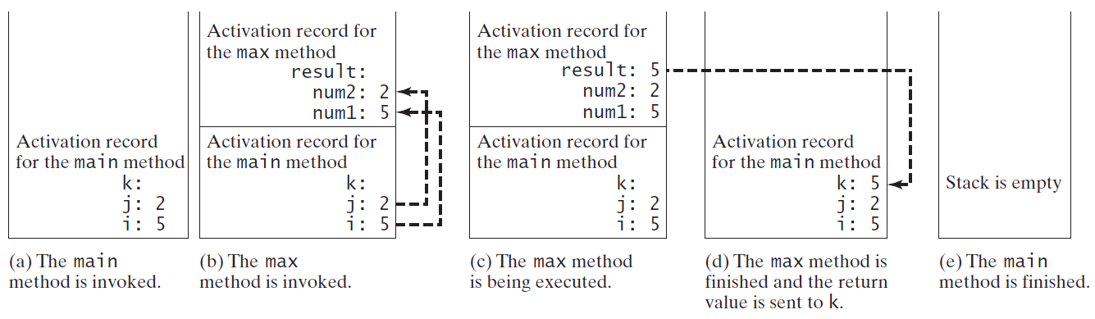
Call Stacks

Slide 28
Trace Call Stack
animation
i is declared and initialized

Slide 29
Trace Call Stack
animation
j is declared and initialized

Slide 30
Trace Call Stack
animation
Declare k

Slide 31
Trace Call Stack
animation
Invoke max(i, j)

Slide 32
Trace Call Stack
animation
pass the values of i and j to num1 and num2

Slide 33
Trace Call Stack
animation
Declare result

Slide 34
Trace Call Stack
animation
(num1 > num2) is true

Slide 35
Trace Call Stack
animation
Assign num1 to result

Slide 36
Trace Call Stack
animation
Return result and assign it to k

Slide 37
Trace Call Stack
animation
Execute print statement

Slide 38
void Method Example
This type of method does not return a value. The method performs some actions.
TestVoidMethod
Run
TestReturnGradeMethod
Run

Slide 39
☑ Check Point
What are the benefits of using a method?
How do you simplify the max method using the conditional operator? public static int max(int num1, int num2) { int result; if (num1 > num2) result = num1; else result = num2; return result; }
<--- ANSWER --->
At least three benefits: (1) Reuse code; (2) Reduce complexity; (3) Easy to maintain.
return (num1 > num2) ? num1 : num2;

Slide 40
☑ Check Point
True | False ? A call to a method with a void return type is always a statement itself.
True | False ? A call to a value-returning method cannot be a statement by itself.
<--- ANSWER --->
True -> A call to a method with a void return type is always a statement itself.
False -> A call to a value-returning method is always a component of an expression. Note that a value-returning method can also be invoked as a statement in Java. In this case, the caller simply ignores the return value.

Slide 41
☑ Check Point
What is the return type of a main method?
What would be wrong with not writing a return statement in a value-returning method?
Can you have a return statement in a void method? Does the return statement in the following method cause syntax errors? public static void xMethod(double x, double y) { System.out.println(x + y); return x + y; }
<--- ANSWER --->
void
A syntax error occurs if a return statement is not used to return a value in a value-returning method.
You can have a return statement in a void method, which simply exits the method. But a return statement cannot return a value such as return x + y in a void method.

Slide 42
☑ Check Point
Write method headers (not the bodies) for the following methods:
(a) Return a sales commission, given the sales amount and the commission rate.
(b) Display the calendar for a month, given the month and year.
(c) Return a square root of a number.
(d) Test whether a number is even, and returning true if it is.
(e) Display a message a specified number of times.
(f) Return the monthly payment, given the loan amount, number of years, and annual interest rate.
(g) Return the corresponding uppercase letter, given a lowercase letter.
<--- ANSWER --->
(a) public static double getCommission(double salesAmount, double commissionRate)
(b) public static void printCalendar(int month, int year)
(c) public static double sqrt(double value)
(d) public static boolean isEven(int value)
(e) public static void printMessage(String message, int times)
(f) public static double monthlyPayment(double loan, int numberOfYears, double annualInterestRate)
(g) public static char getUpperCase(char letter)

Slide 43
☑ Check Point
Identify and correct the errors in the following program: 1 public class Test { 2 public static method1(int n, m) { 3 n += m; 4 method2(3.4); 5 } 6 7 public static int method2(int n) { 8 if (n > 0) return 1; 9 else if (n == 0) return 0; 10 else if (n < 0) return -1; 11 } 12 }
<--- ANSWER --->
Line 2: method1 is not defined correctly. It does not have a return type or void.
Line 2: type int should be declared for parameter m.
Line 7: parameter type for n should be double to match method2(3.4).
Line 10: if (n < 0) should be removed in method, otherwise a compile error is reported.

Slide 44
Passing Parameters
public static void nPrintln(String message, int n) {
for (int i = 0; i < n; i++)
System.out.println(message);
}
Suppose you invoke the method using
nPrintln(“Welcome to Java”, 5);
What is the output?
Suppose you invoke the method using
nPrintln(“Computer Science”, 15);
What is the output?
Can you invoke the method using
nPrintln(15, “Computer Science”);

Slide 45
Pass by Value
This program demonstrates passing values to the methods.
Increment
Run

Slide 46
Pass by Value
Testing Pass by value
This program demonstrates passing values to the methods.
TestPassByValue
Run

Slide 47
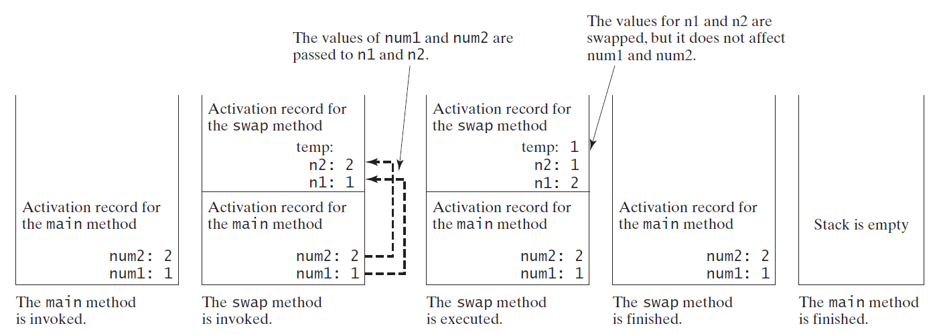
Pass by Value, cont.

Slide 48
☑ Check Point
How is an argument passed to a method?
Can the argument have the same name as its parameter?
Identify and correct the errors in the following program: 1 public class Test { 2 public static void main(String[] args) { 3 nPrintln(5, "Welcome to Java!"); 4 } 5 6 public static void nPrintln(String message, int n) { 7 int n = 1; 8 for (int i = 0; i < n; i++) 9 System.out.println(message); 10 } 11 }
<--- ANSWER --->
You pass actual parameters by passing the right type of value in the right order.
The actual parameter can have the same name as its formal parameter.
Two errors -> (1) The arguments are not passed in the right order. (2) n is a parameter, but is redeclared in the nPrintln method in line 7.

Slide 49
☑ Check Point
What is pass-by-value?
Show the result of the following programs. (a) public class Test { public static void main(String[] args) { int max = 0; max(1, 2, max); System.out.println(max); } public static void max( int value1, int value2, int max) { if (value1 > value2) max = value1; else max = value2; } }
<--- ANSWER --->
"Pass by value" is to pass a copy of the value to the method.
(a) The output of the program is 0, because the variable max is not changed by invoking the method max.
(b) public class Test { public static void main(String[] args) { int i = 1; while (i <= 6) { method1(i, 2); i++; } } public static void method1( int i, int num) { for (int j = 1; j <= i; j++) { System.out.print(num + " "); num *= 2; } System.out.println(); } }
<--- ANSWER --->
(b) 2 2 4 2 4 8 2 4 8 16 2 4 8 16 32 2 4 8 16 32 64

Slide 50
☑ Check Point
Show the result of the following programs. (c) public class Test { public static void main(String[] args) { // Initialize times int times = 3; System.out.println("Before the call," + " variable times is " + times); // Invoke nPrintln and display times nPrintln("Welcome to Java!", times); System.out.println("After the call," + " variable times is " + times); } // Print the message n times public static void nPrintln( String message, int n) { while (n > 0) { System.out.println("n = " + n); System.out.println(message); n--; } } }
<--- ANSWER --->
(c) Before the call, variable times is 3 n = 3 Welcome to Java! n = 2 Welcome to Java! n = 1 Welcome to Java! After the call, variable times is 3
(d) public class Test { public static void main(String[] args) { int i = 0; while (i <= 4) { method1(i); i++; } System.out.println("i is " + i); } public static void method1(int i) { do { if (i % 3 != 0) System.out.print(i + " "); i--; } while (i >= 1); System.out.println(); } }
<--- ANSWER --->
(d) 1 2 1 2 1 4 2 1 i is 5

Slide 51
Modularizing Code
Methods can be used to reduce redundant coding and enable code reuse.
Methods can also be used to modularize code and improve the quality of the program.
By encapsulating the code for obtaining the gcd in a method, this program has several
advantages:
1. It isolates the problem for computing the gcd from the rest of the code in the main method. Thus, the logic becomes clear and the program is easier to read.
2. The errors on computing the gcd are confined in the gcd method, which narrows the scope of debugging.
3. The gcd method now can be reused by other programs.
GreatestCommonDivisorMethod
Run
PrimeNumberMethod
Run

Slide 52
☑ Check Point
Trace the gcd method to find the return value for gcd(4, 6).
Trace the isPrime method to find the return value for isPrime(25).
<--- ANSWER --->
gcd(4, 6) returns 2.
isPrime(25) returns false.

Slide 53
Case Study: Converting Hexadecimals to Decimals
Write a method that converts a hexadecimal number into a decimal number.
ABCD =>
A*16^3 + B*16^2 + C*16^1+ D*16^0
= ((A*16 + B)*16 + C)*16+D
= ((10*16 + 11)*16 + 12)*16+13 = ?
Hex2Dec
Run

Slide 54
☑ Check Point
What is hexCharToDecimal('B')?
What is hexCharToDecimal('7')?
What is hexToDecimal('A9')?
<--- ANSWER --->
hexCharToDecimal('B') returns 11.
hexCharToDecimal('7') returns 7.
hexToDecimal("A9") returns 169.

Slide 55
Overloading Methods
Overloading the max Method
public static double max(double num1, double num2) {
if (num1 > num2)
return num1;
else
return num2;
}
TestMethodOverloading
Run

Slide 56
Overloading Methods
Overloading methods enables you to define the methods with the same name as long as their signatures are different.
Overloading methods can make programs clearer and more readable.
Methods that perform the same function with different types of parameters should be given the same name.
Overloaded methods must have different parameter lists. You cannot overload methods based on different modifiers or return types.

Slide 57
Ambiguous Invocation
Sometimes there may be two or more possible matches for an invocation of a method, but the compiler cannot determine the most specific match.
This is referred to as ambiguous invocation.
Ambiguous invocation is a compile error.

Slide 58
Ambiguous Invocation
public class AmbiguousOverloading {
public static void main(String[] args) {
System.out.println(max(1, 2));
}
public static double max(int num1, double num2) {
if (num1 > num2)
return num1;
else
return num2;
}
public static double max(double num1, int num2) {
if (num1 > num2)
return num1;
else
return num2;
}
}

Slide 59
☑ Check Point
What is method overloading?
Is it permissible to define two methods that have the same name but different parameter types?
Is it permissible to define two methods in a class that have identical method names and parameter lists but different return value types or different modifiers?
<--- ANSWER --->
Two methods with the same name, defined in the same class, is called method overloading.
It is fine to have same method name, but different parameter types.
You cannot overload methods based on return type, or modifiers.

Slide 60
☑ Check Point
What is wrong in the following program? public class Test { public static void method(int x) { } public static int method(int y) { return y; } }
<--- ANSWER --->
Methods public static void method(int x) and public static int method(int y) have the same signature method(int).

Slide 61
☑ Check Point
Given two method definitions, public static double m(double x, double y) public static double m(int x, double y) tell which of the two methods is invoked for:
(a) double z = m(4, 5);
(b) double z = m(4, 5.4);
(c) double z = m(4.5, 5.4);
<--- ANSWER --->
(a) invokes the second method.
(b) invokes the second method.
(c) invokes the first method.

Slide 62
Scope of Local Variables
A local variable: a variable defined inside a method.
Scope: the part of the program where the variable can be referenced.
The scope of a local variable starts from its declaration and continues to the end of the block that contains the variable. A local variable must be declared before it can be used.

Slide 63
Scope of Local Variables, cont.
You can declare a local variable with the same name multiple times in different non-nesting blocks in a method, but you cannot declare a local variable twice in nested blocks.

Slide 64
Scope of Local Variables, cont.
A variable declared in the initial action part of a for loop header has its scope in the entire loop. But a variable declared inside a for loop body has its scope limited in the loop body from its declaration and to the end of the block that contains the variable.

Slide 65
Scope of Local Variables, cont.

Slide 66
Scope of Local Variables, cont.
// Fine with no errors
public static void correctMethod() {
int x = 1;
int y = 1;
// i is declared
for (int i = 1; i < 10; i++) {
x += i;
}
// i is declared again
for (int i = 1; i < 10; i++) {
y += i;
}
}

Slide 67
Scope of Local Variables, cont.
// With errors
public static void incorrectMethod() {
int x = 1;
int y = 1;
for (int i = 1; i < 10; i++) {
int x = 0;
x += i;
}
}

Slide 68
☑ Check Point
What is a local variable?
What is the scope of a local variable?
<--- ANSWER --->
A local variable is a variable declared inside a method.
The scope of a local variable starts from its declaration and continues to the end of the block that contains the variable.

Slide 69
Case Study: Generating Random Characters
Computer programs process numerical data and characters. You have seen many examples that involve numerical data. It is also important to understand characters and how to process them.
As introduced in Section 4.3, each character has a unique Unicode between 0 and FFFF in hexadecimal (65535 in decimal). To generate a random character is to generate a random integer between 0 and 65535 using the following expression: (note that since 0 <= Math.random() < 1.0, you have to add 1 to 65535.)
(int)(Math.random() * (65535 + 1))

Slide 70
Case Study: Generating Random Characters, cont.
Now let us consider how to generate a random lowercase letter. The Unicode for lowercase letters are consecutive integers starting from the Unicode for 'a', then for 'b', 'c', ..., and 'z'. The Unicode for 'a' is
(int)'a'
So, a random integer between (int)'a' and (int)'z' is
(int)((int)'a' + Math.random() * ((int)'z' - (int)'a' + 1)

Slide 71
Case Study: Generating Random Characters, cont.
As discussed in Chapter 2, all numeric operators can be applied to the char operands. The char operand is cast into a number if the other operand is a number or a character. So, the preceding expression can be simplified as follows:
'a' + Math.random() * ('z' - 'a' + 1)
So, a random lowercase letter is
(char)('a' + Math.random() * ('z' - 'a' + 1))

Slide 72
Case Study: Generating Random Characters, cont.
To generalize the foregoing discussion, a random character between any two characters ch1 and ch2 with ch1 < ch2 can be generated as follows:
(char)(ch1 + Math.random() * (ch2 – ch1 + 1))

Slide 73
The RandomCharacter Class
// RandomCharacter.java: Generate random characters
public class RandomCharacter {
/** Generate a random character between ch1 and ch2 */
public static char getRandomCharacter(char ch1, char ch2) {
return (char)(ch1 + Math.random() * (ch2 - ch1 + 1));
}
/** Generate a random lowercase letter */
public static char getRandomLowerCaseLetter() {
return getRandomCharacter('a', 'z');
}
/** Generate a random uppercase letter */
public static char getRandomUpperCaseLetter() {
return getRandomCharacter('A', 'Z');
}
/** Generate a random digit character */
public static char getRandomDigitCharacter() {
return getRandomCharacter('0', '9');
}
/** Generate a random character */
public static char getRandomCharacter() {
return getRandomCharacter('\u0000', '\uFFFF');
}
}
RandomCharacter
TestRandomCharacter
Run

Slide 74
Method Abstraction
You can think of the method body as a black box that contains the detailed implementation for the method.

Slide 75
Benefits of Methods
Write a method once and reuse it anywhere.
Information hiding (or, encapsulation). Hide the implementation from the user.
Reduce complexity.

Slide 76
Stepwise Refinement (Optional)
The concept of method abstraction can be applied to the process of developing programs.
When writing a large program, you can use the “divide and conquer” strategy, also known as stepwise refinement, to decompose it into subproblems.
The subproblems can be further decomposed into smaller, more manageable problems.

Slide 77
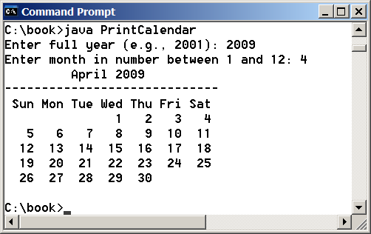
PrintCalender Case Study
Let us use the PrintCalendar example to demonstrate the stepwise refinement approach.
PrintCalendar
Run

Slide 78
Design Diagram

Slide 79
Design Diagram

Slide 80
Design Diagram

Slide 81
Design Diagram

Slide 82
Design Diagram

Slide 83
Design Diagram

Slide 84
Design Diagram

Slide 85
Implementation: Top-Down
Top-down approach is to implement one method in the structure chart at a time from the top to the bottom.
Stubs can be used for the methods waiting to be implemented. A stub is a simple but incomplete version of a method.
The use of stubs enables you to test invoking the method from a caller.
Implement the main method first and then use a stub for the printMonth method. For example, let printMonth display the year and the month in the stub. Thus, your program may begin like this:
A Skeleton for printCalendar

Slide 86
Implementation: Bottom-Up
Bottom-up approach is to implement one method in the structure chart at a time from the bottom to the top.
For each method implemented, write a test program to test it.
Both top-down and bottom-up methods are fine. Both approaches implement the methods incrementally and help to isolate programming errors and makes debugging easy. Sometimes, they can be used together.

Slide 87
Benefits of Stepwise Refinement
Simpler Program
Reusing Methods
Easier Developing, Debugging, and Testing
Better Facilitating Teamwork
Notes:
Stepwise refinement breaks a large problem into smaller manageable subproblems. Each subproblem can be implemented using a method. This approach makes the program easier to write, reuse, debug, test, modify, and maintain.
-- Simpler Program: The print calendar program is long. Rather than writing a long sequence of statements in one method, stepwise refinement breaks it into smaller methods. This simplifies the program and makes the whole program easier to read and understand.
-- Reusing Methods: Stepwise refinement promotes code reuse within a program. The isLeapYear method is defined once and invoked from the getTotalNumberOfDays and getNumberOfDayInMonth methods. This reduces redundant code.
-- Easier Developing, Debugging, and Testing: Since each subproblem is solved in a method, a method can be developed, debugged, and tested individually. This isolates the errors and makes developing, debugging, and testing easier. When implementing a large program, use the top-down and/or bottom-up approach. Do not write the entire program at once. Using these approaches seems to take more development time (because you repeatedly compile and run the program), but it actually saves time and makes debugging easier.
-- Better Facilitating Teamwork: When a large problem is divided into subprograms, subproblems can be assigned to different programmers. This makes it easier for programmers to work in teams.

